Slide 1

From distress to direction: leading the repositioning of a Class A office portfolio.
Presented by Gabe Whitman

Slide 2

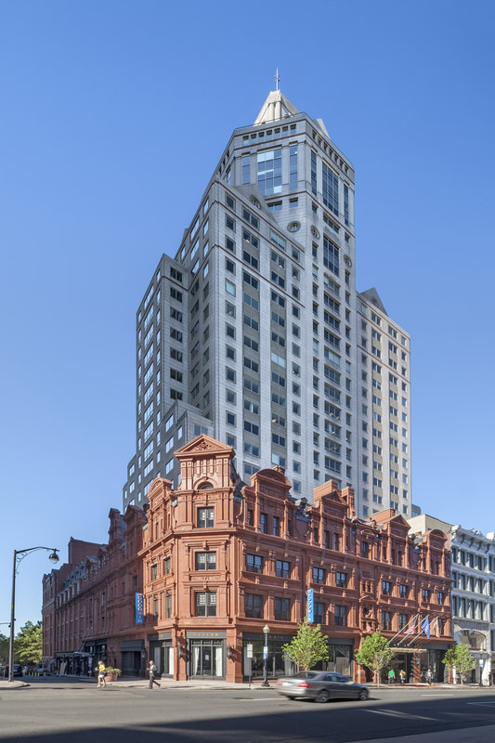
National Leasing Director
Commercial real estate leader with 20 years experience
Oversee leasing strategy for a 7M SF office portfolio across newly expanded markets (NC, OH, IL, CT, MN)
Executed approximately 700,000 SF of leasing since Q4 2024, with a current pipeline exceeding 1,000,000 SF

Slide 3
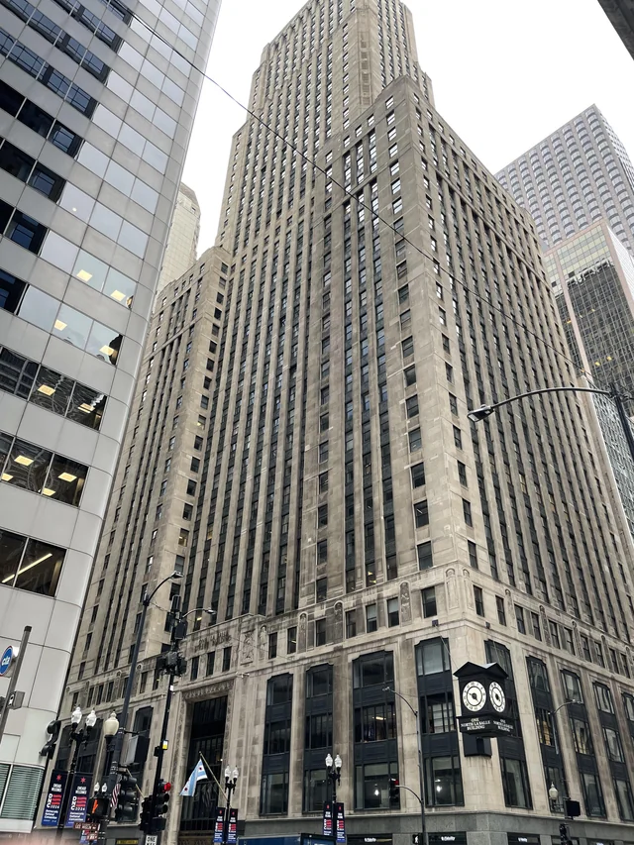
Why Buy Office Buildings in Today’s Market?
1. Basis Reset = Upside
Office assets are trading 40–70% below peak -Buy at a basis well below replacement cost, you’re often buying: Land, Long-term optionality, Cash flow - When you control basis, you control risk.
2. Distressed Debt & Forced Sellers
The opportunity isn’t “office is great.” The opportunity is: Loan maturities, Banks reducing exposure, Funds needing liquidity: This creates pricing dislocation and big returns
3. Flight to Quality Is Real
Well-located, well-amenitized Class A assets are stabilizing. Tenants aren’t abandoning office — they’re consolidating into better buildings. If you buy: Prime location, Strong infrastructure, Good floor plates, Manageable capex; You can win the “consolidation trade.”
4. Repositioning & Active Leasing Upside
Aggressive leasing strategy: concessions, TIA, operational execution separates winners from losers – Central Business Dist. Transportation, urban will reprice but not disappear
5. Alternative Use: Life Science, Medical, Residential – buy below land value creates multiple exits

Slide 4
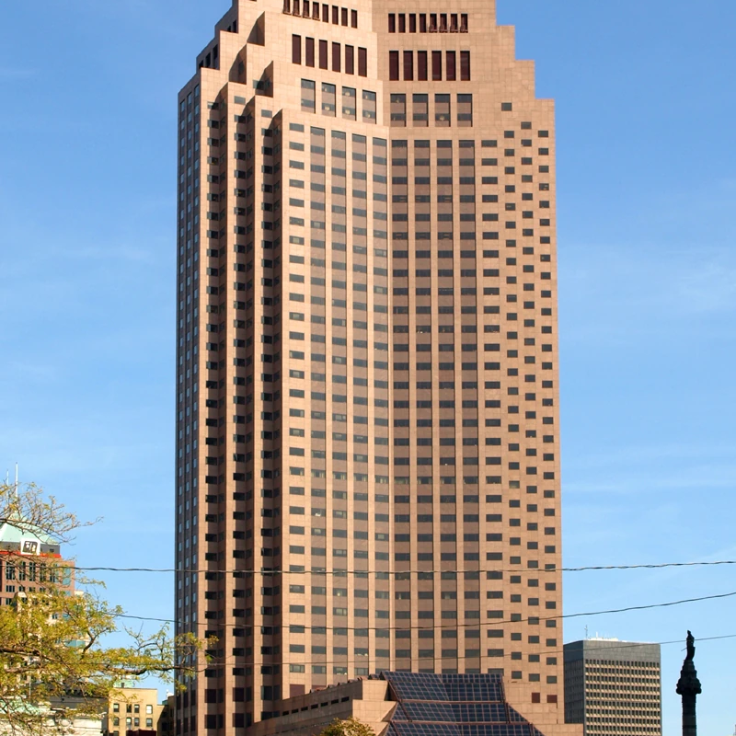
Investment Profile
All-cash acquisitions
20+ Cap Rates
Top-tier Class A assets
Underwritten to survive on: Existing tenants, Planned renewals and expected vacates
Well-maintained properties requiring minimal capital improvements
Can be as little as 50%+ leased at acquisition
Strong preference for vacancy concentrated in the tower rather than fragmented throughout the building

Slide 5


Operating Strategy Assets often previously owned by institutional funds with limited expense discipline Immediate focus on: -Right-sizing staffing -Renegotiating service contracts -Optimizing cleaning, maintenance, gym, and cafeteria operations

Slide 6
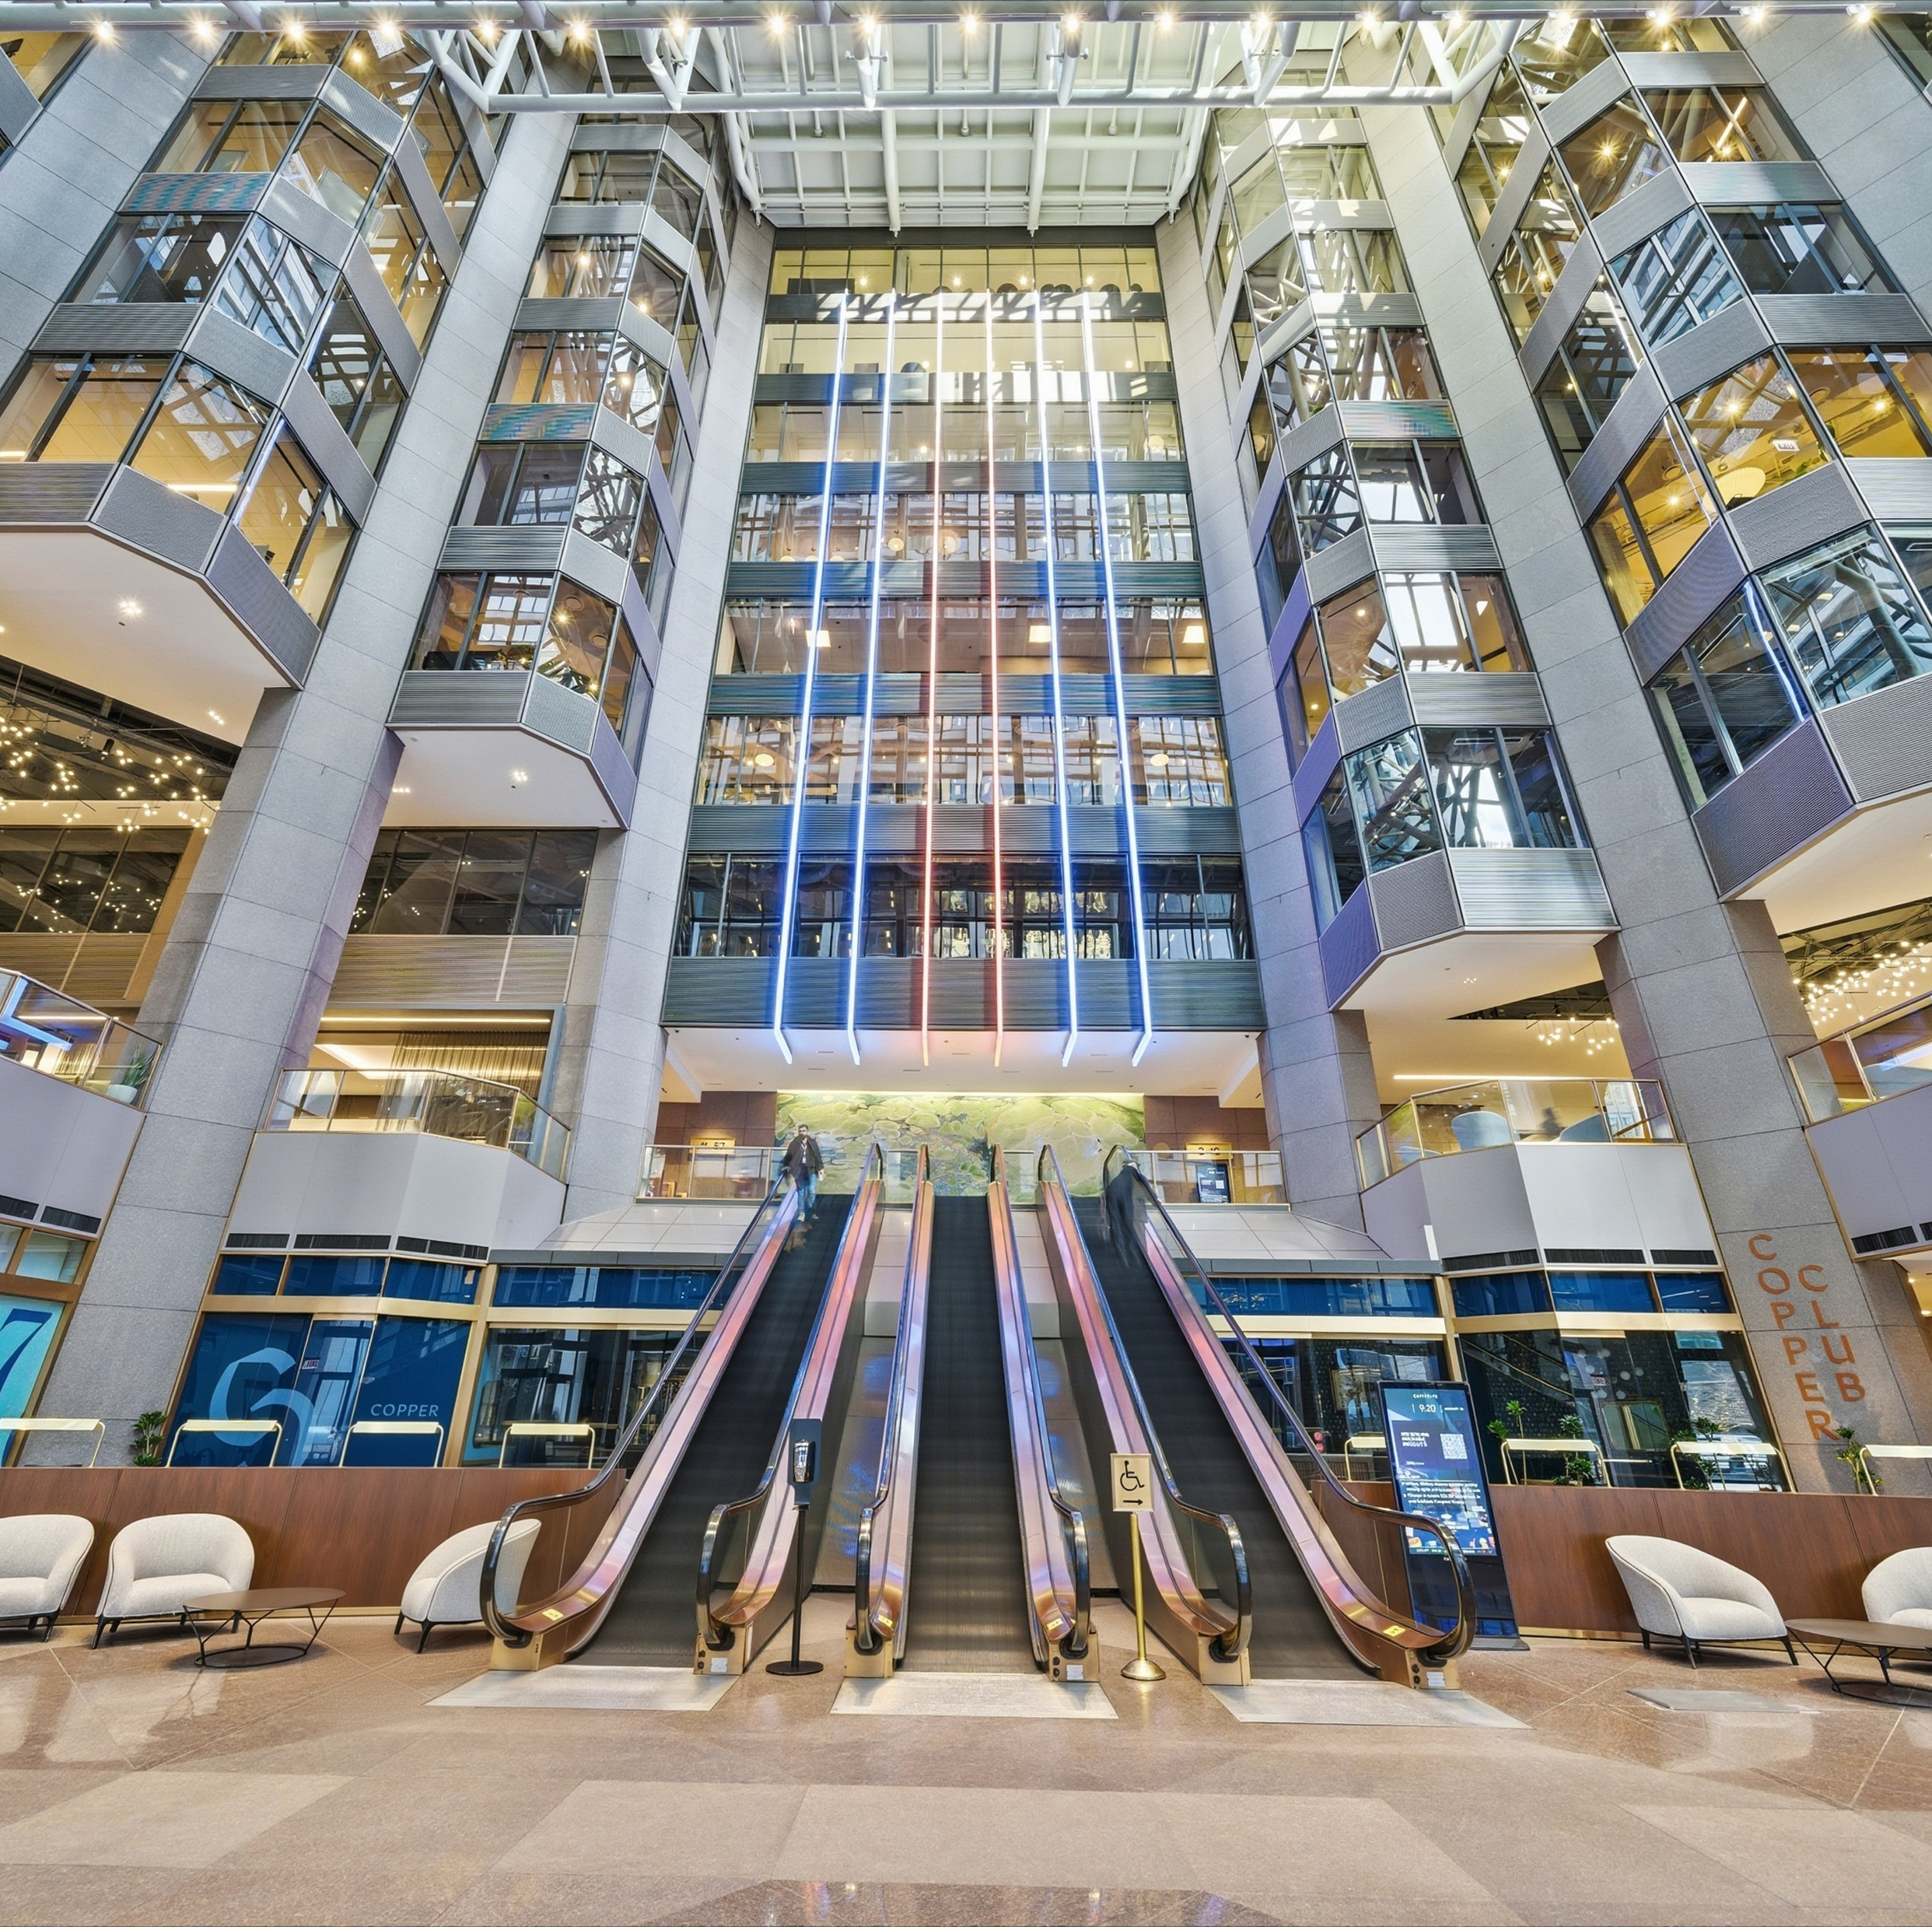

Speed & Continuity Ability to close quickly allows us to: -Reactivate deals while the contract is still out Reactivating Demand -Re-engage renewal deals that stalled under prior ownership -Reconnect with qualified prospects who wanted space but could not transact previously Broker Alignment -Will retain incumbent brokers if aligned with our strategy -Interview alternative teams/firms to ensure hands-on execution -Willingness to adapt away from prior “pre-build on spec” approaches
STRATEGY

Slide 7
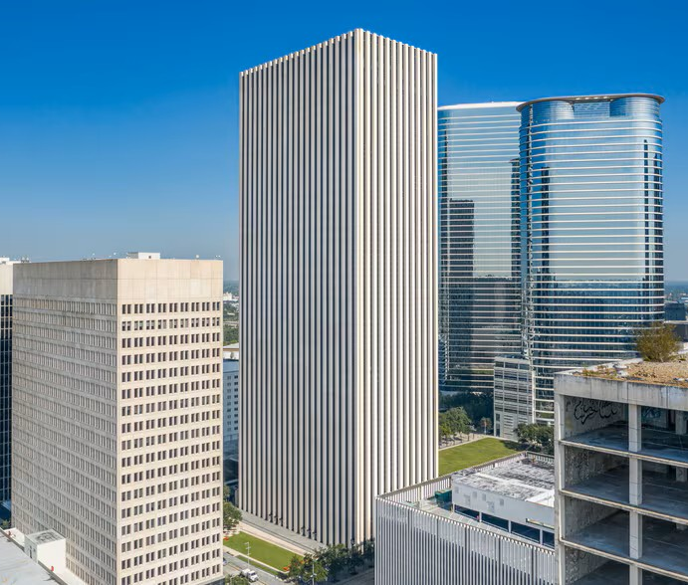
Thank you
Questions?

